Slide 1

Understanding Search Engine Optimization (SEO)
A quick guide to SEO and analytics
-Final Project by Raksha Deshpande

Slide 2
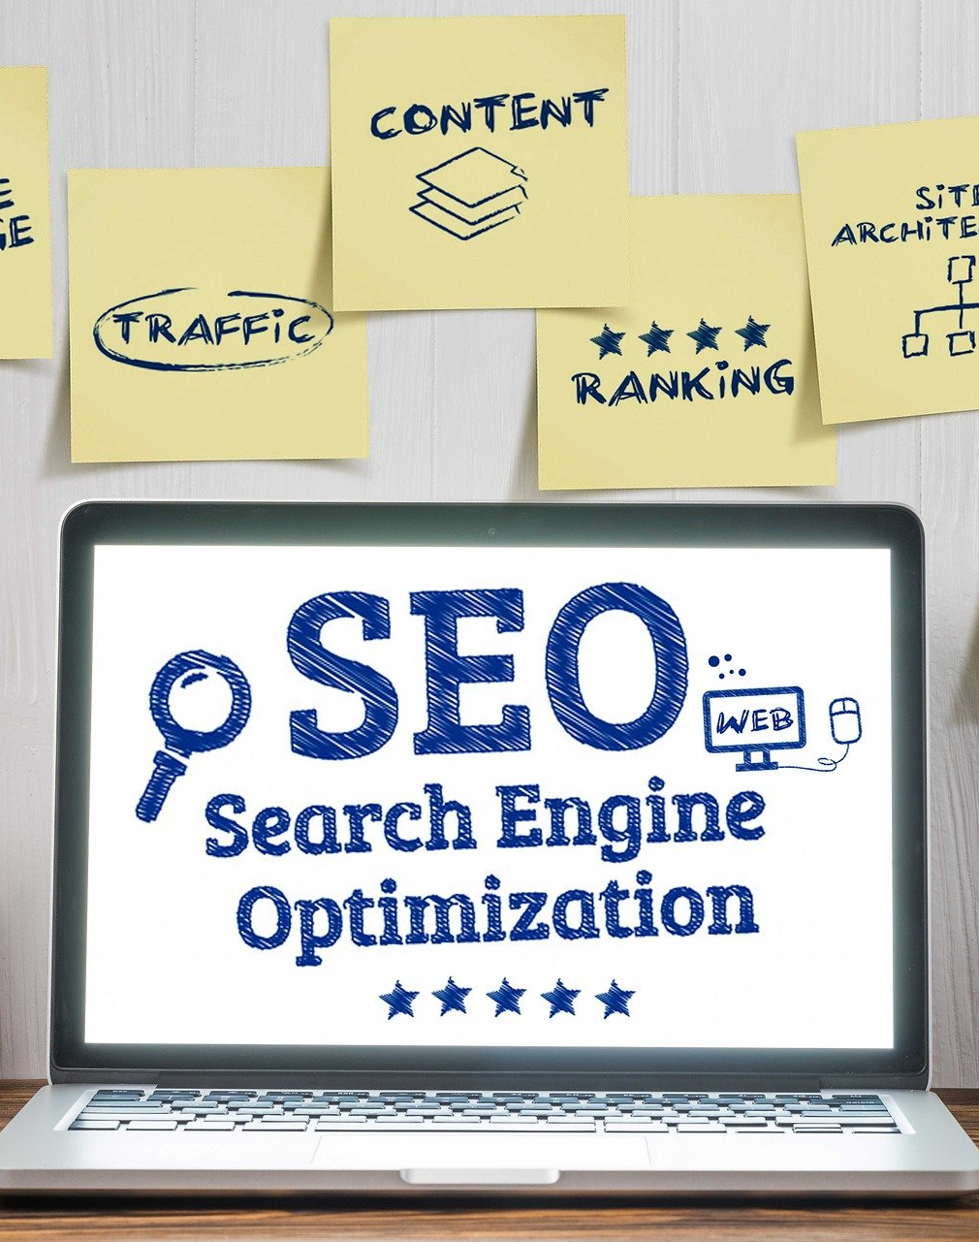
Introduction
What is it?
History
Who are the users?
Who are the audience?
Why is it important?

Slide 3
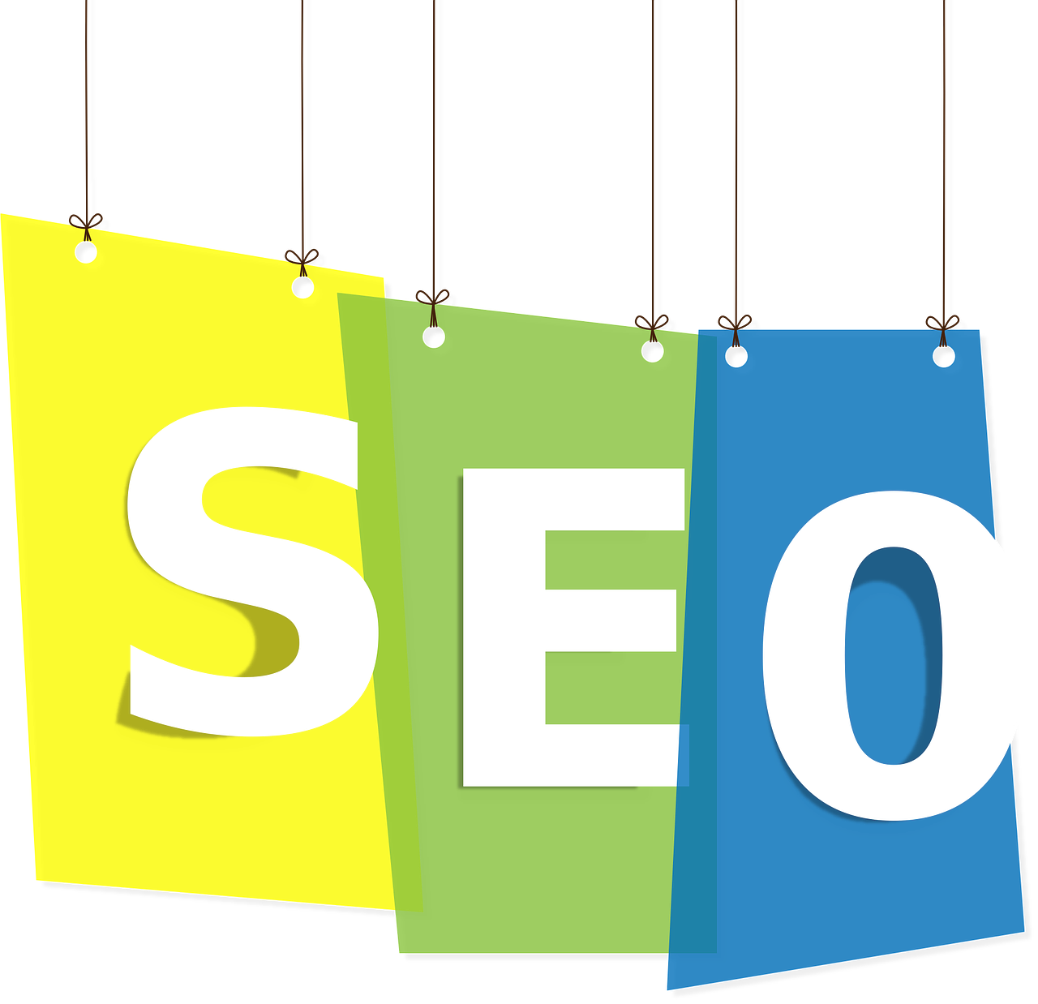
What is it?
https://youtu.be/sd0ypO9MTWY
The process of improving your website’s visibility when users search for products or services related to your business onto search engines like Google and Bing.
The better visibility your site pages have in search results, the more likely you are to garner attention and attract customers.

Slide 4
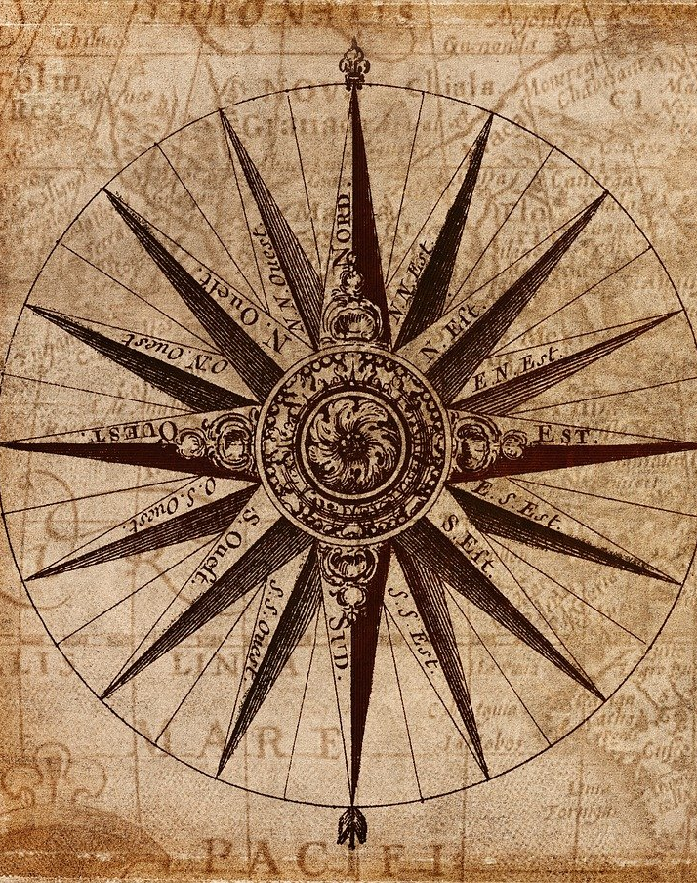
History
It is believed that SEO was born in 1991. Around this time, the world’s first website was launched, and one quickly turned into many, leading to creation of world’s first search engines.
In 1993, Excite revolutionized how information was categorized, and in 1994, Alta Vista, Yahoo, and others joined the club.
However, in 1996, SEO really took off when Sergey Brin and Larry Page began building what would become the biggest, most recognized search engine to date:BackRub. Thought it was Google? Well, you’re right because BackRub eventually became Google and was registered as a domain in 1997.
SEO's history teaches us that the best way to prepare for the future of SEO is to not cut corners; it's to use ethical optimization techniques and publish content that holds actual value for your visitors.

Slide 5

Who are the users?
Any company with an existing website can benefit from search engine optimization. Not only can it help increase visibility and rankings, but it can also drive more organic traffic and bring paying customers.
Some common ones include:
Start-Up Businesses
Service Professionals and Companies
Local Entrepreneurs
Competing Brands
Medical Practices
Online Businesses
Real Estates
Restaurants
Pet Services

Slide 6

Who are the audience?
The target audience are current or potential customers using search engines to find businesses.
In other words, specific group of consumers who most likely want to use SEO users’ product or service, and therefore, should see their ad campaigns.
Target audience may be dictated by age, gender, income, location, interests or a myriad of other factors as per requirement.

Slide 7

Why is it important?
https://youtu.be/jZy3Ry1aaAc
Search engine optimization brings "free" and organic traffic to your site i.e., high-quality pages that answer audiences’ query will show up at the top of the SERP (Search Engine Results Page) and you won't need to pay for clicks.
On that same SERP, there are typically paid results as well; they are identifiable by the ‘Ad’ icon to the left. When a user clicks on a paid result and visits the site, the advertiser pays the search engine for that visit.

Slide 8
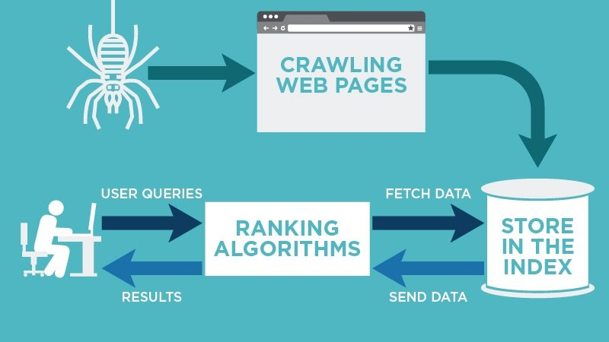
How does SEO work?
https://youtu.be/K5qOuoj_dwA
1. Crawling
2. Indexing
3. Ranking
4. Keyword search
5. Optimization
& results

Slide 9
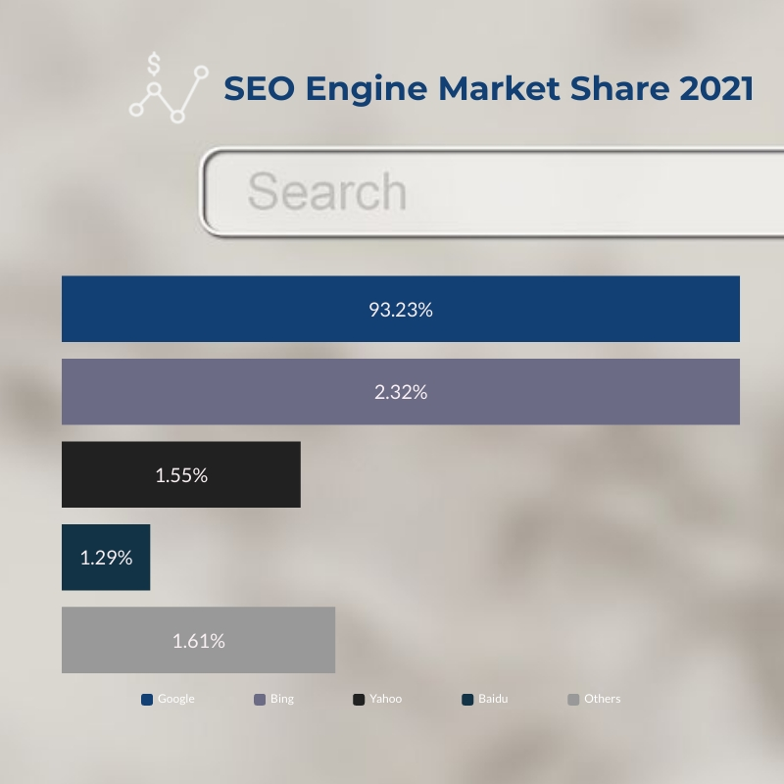
Google vs. Rest of the Search Engines
Google dominates search in most countries across the globe, almost to the point of being a monopoly, particularly in English. In English, worldwide, 88% of searches on desktop are on Google. On mobile, that figure is a whopping 96%.
Bing and Yahoo combined account for 1.5% of searches on mobile and 8% of searches on desktop. That makes Google vastly dominant. And by far, the most important search engine you should be focusing on.
Note: Chart created with visme.com

Slide 10
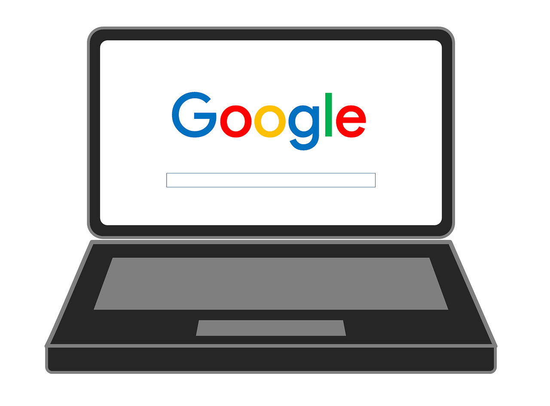
How does Google SEO work?
Google says, “ we are organizing the content of the web.”
Google is striving to recommend the most relevant answer from the most trustworthy source in the most appropriate format for its user.
Relevant - Google aims to match the best answer to the question it has understood. That is relevancy in a nutshell.
Trustworthy - Google wants to send its users to content from a source it is confident will satisfy its user — a credible brand or person it trusts.
Consumable - This is an awful word, and I apologize, but Google wants to send its users to the kind of content they want to engage with, in a format they can consume.
P.S: Google is constantly updating its algorithm daily. But most of these updates are small and won’t lead to noticeable changes in ranking or traffic for individual brands like yours.

Slide 11

How can one learn SEO?
While many SEOs specialize in specific areas, it’s crucial to take a holistic approach to your strategy and cover all your bases:
Technical SEO: Includes indexation, crawling, site speed, website architecture, structured markup, and more to ensure your website is set up in a way that is accessible to search engines. You can use tools including page speed checkers like GTMetrix, or page crawlers like our Site Audit tool.
Local SEO: Includes maintaining your business profile, managing reviews, optimizing for voice search, etc. to earn a local presence for your business. You should manage your reviews, keep any directory listings up-to-date and uniform, and optimize location pages.

Slide 12
How can one learn SEO?
On-Page SEO: Includes content, keywords, images, title tags, internal links, and essentially anything on the actual web page. There are many keyword research tools out there that can help you get started with the keyword research phase, like the Keyword Magic Tool.
Off-Page SEO: Includes actions taken outside of your own website to influence rankings, including building backlinks, implementing a social media strategy, engaging in influencer marketing, and more. You can use tools like the Backlink Gap tool to identify the sites to reach out to.

Slide 13

Editors and SEO
Editorial teams are often put into the front line of SEO.
What is in SEO for editors?
1) More readers for your stories.
2) Get promoted and earn more money.
If yours are the stories that get the most readers, mentions and response, that should help you.
What do writers and editors need to know about SEO?
How to write headlines: Creating alluring and descriptive headlines for the web followed by editing/reviewing them.
Use of keywords: Put together a target list of keywords and phrases which relate to the central themes of the sites.
Linking: Link to outside sources, when referencing a quote, a piece of research, or perhaps talking about a product or website.

Slide 14
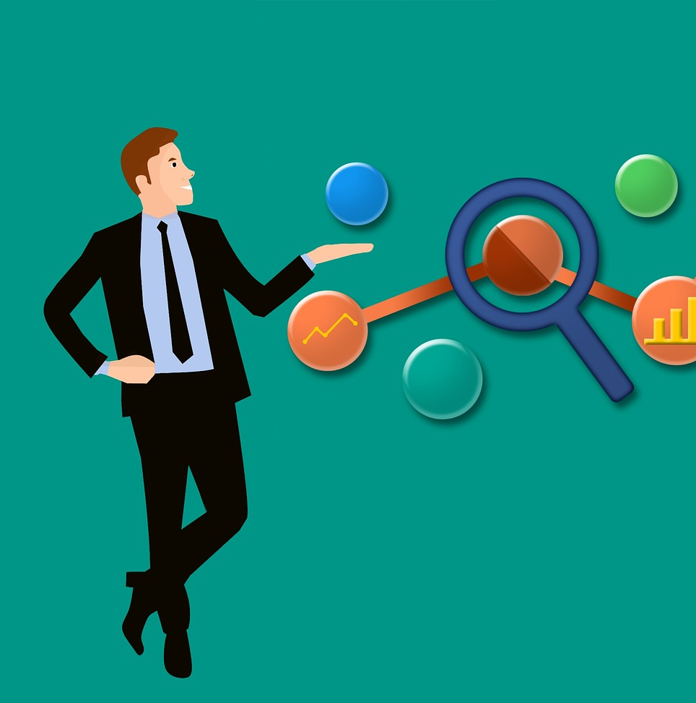
SEO Glossary
Index - Google stores all web pages that it knows about in its index. The index entry for each page describes the content and location (URL) of that page. To index is when Google fetches a page, reads it, and adds it to the index: Google indexed several pages on my site today.
Crawl - The process of looking for new or updated web pages. Google discovers URLs by following links, by reading sitemaps, and by many other means. Google crawls the web, looking for new pages, then indexes them (when appropriate).
Crawler - Automated software that crawls (fetches) pages from the web and indexes them.
Googlebot - The generic name of Google's crawler. Googlebot crawls the web constantly.
SEO - Search engine optimization: the process of making your site better for search engines. Also, the job title of a person who does this for a living: We just hired a new SEO to improve our presence on the web.

Slide 15

Activity
Build a free website through Wix or WordPress and track the results through Google Analytics or through their own statistics pages.
See where the site traffic is coming from with each page created on the website.
Also, connect the new site to all personal social media accounts as well.

Slide 16
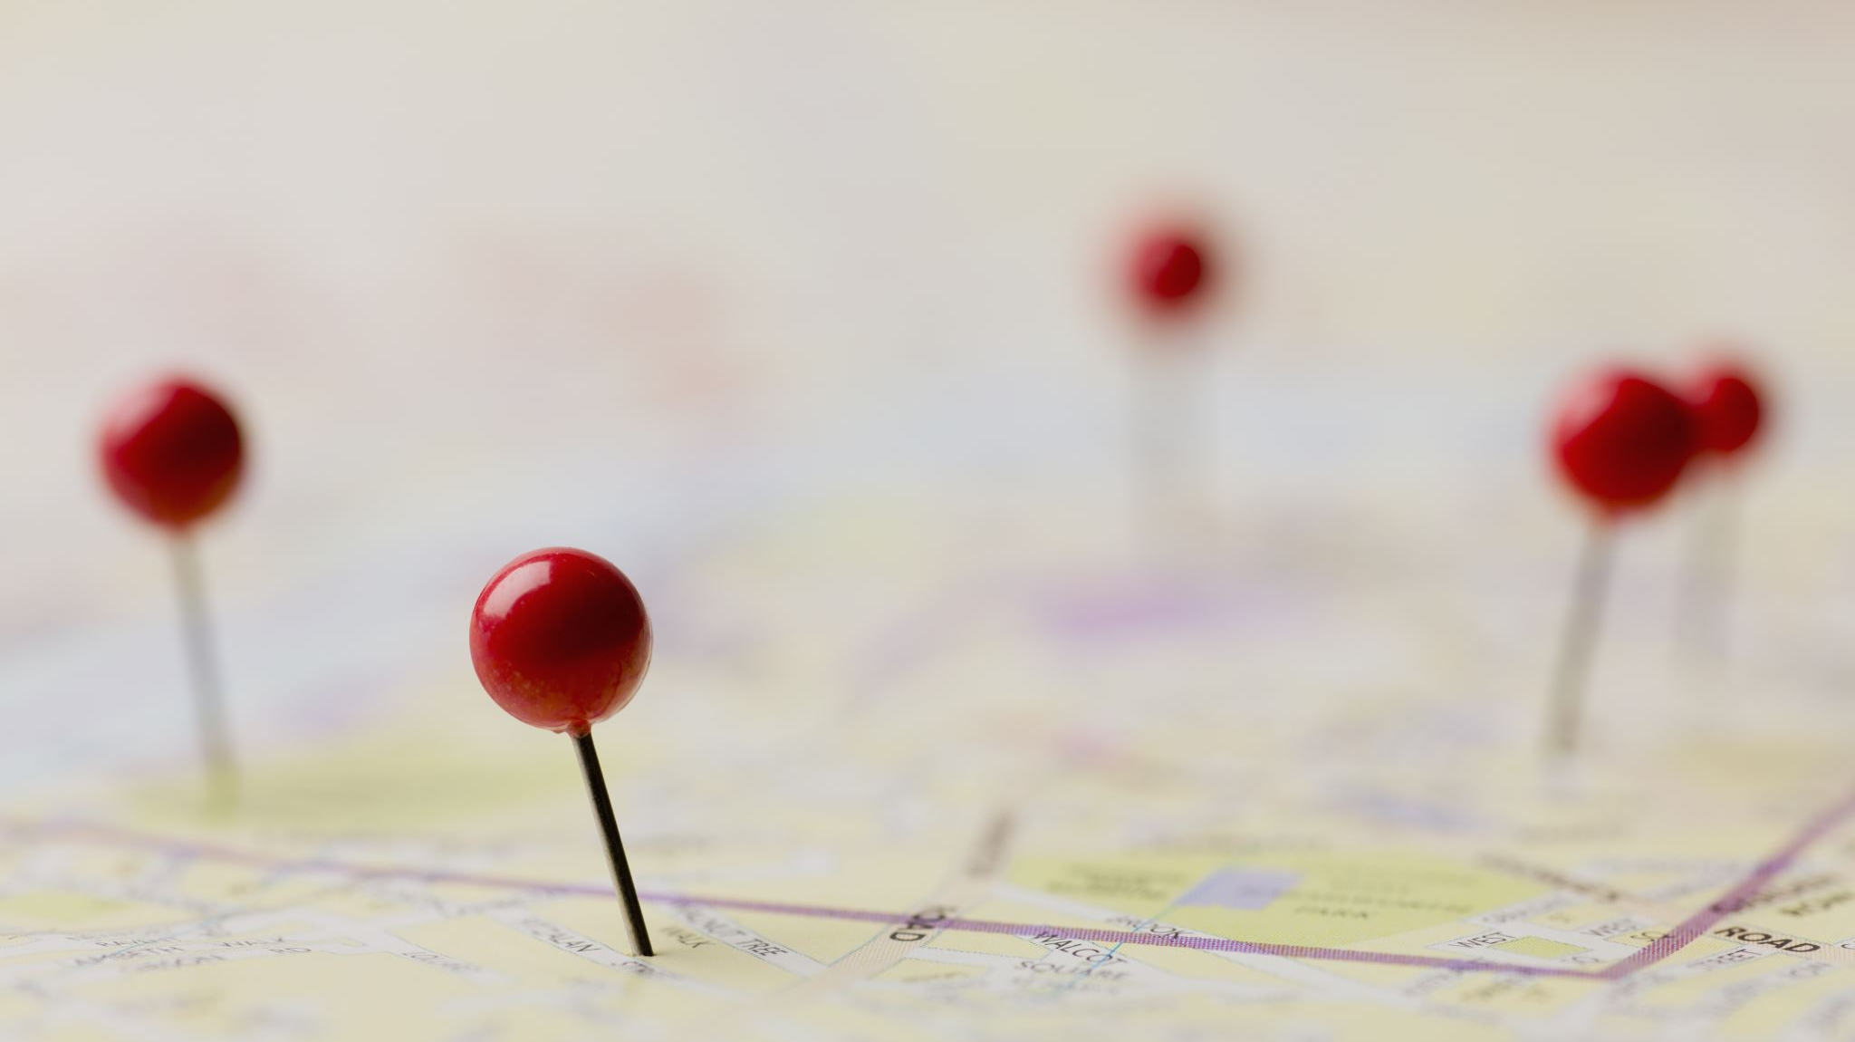
References
https://searchengineland.com/guide/what-is-seo
https://www.bluefrogdm.com/blog/a-brief-history-of-seo
https://www.clickx.io/8-industries-benefit-seo/
https://www.semrush.com/blog/category/seo/what-is-seo/
https://neilpatel.com/blog/deindex-your-pages/
Pixabay.com
Visme.com
Web Design and Company (https://youtu.be/sd0ypO9MTWY)
Dopinger (https://youtu.be/jZy3Ry1aaAc)
Semrush (https://youtu.be/K5qOuoj_dwA)
https://www.wordtracker.com/academy/seo/getting-started/seo-for-editorial-teams-journalists
https://www.searchenginewatch.com/2016/03/15/how-much-do-journalists-and-editors-need-to-know-about-seo/

